Slide 1

PENTRIS
GROUP PROJECT 1-1 Phase 2
Rafael Diederen
Aurelien Giuglaris Michael
Florentine Hegemann
Melis Kulbay
Sonya Ozhogina
Eden Rochman Sharabi

Slide 2

What main problem are we trying to solve
Playable Java Tetris Game with Conditions:
Grid of 5 x 15
Pentominoes Appearing Randomly
Set of Pieces from Phase 1
GUI Tasks
Agents

Slide 3
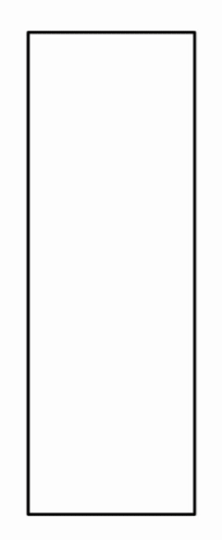
Our solution to the problem:
Making the game playable
Adding GUI
Adding Agent(s)
Results
Conclusion + References
Planning

Slide 4

More Research Topics
Agent similarities / Differences / Efficiencies
Problems in designing GUI
Limitations of our implementation
Going further in implementation

Slide 5
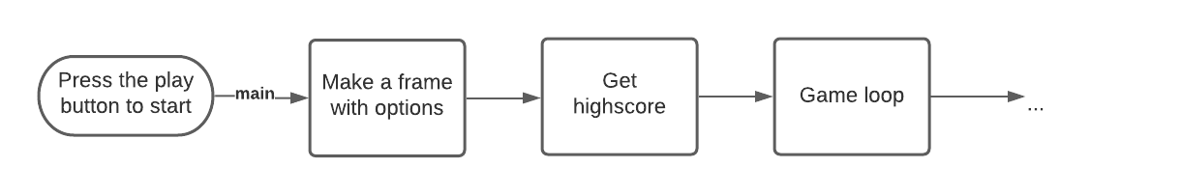
How does the game work? Start

Slide 6
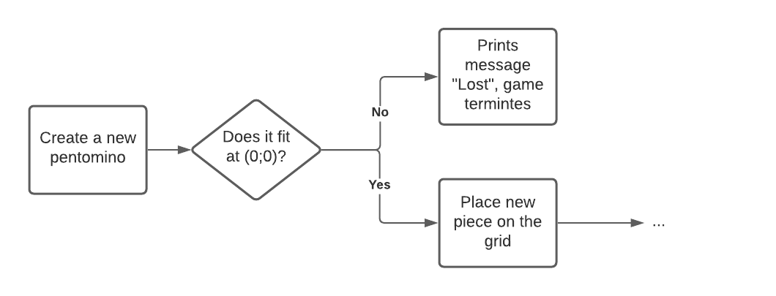
How does the game work? Lost or not

Slide 7
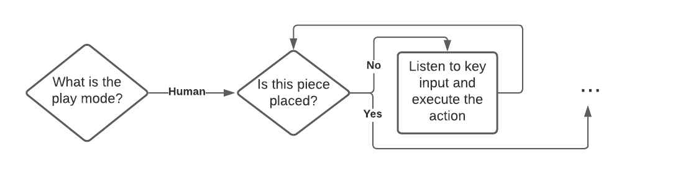
Human mode

Slide 8
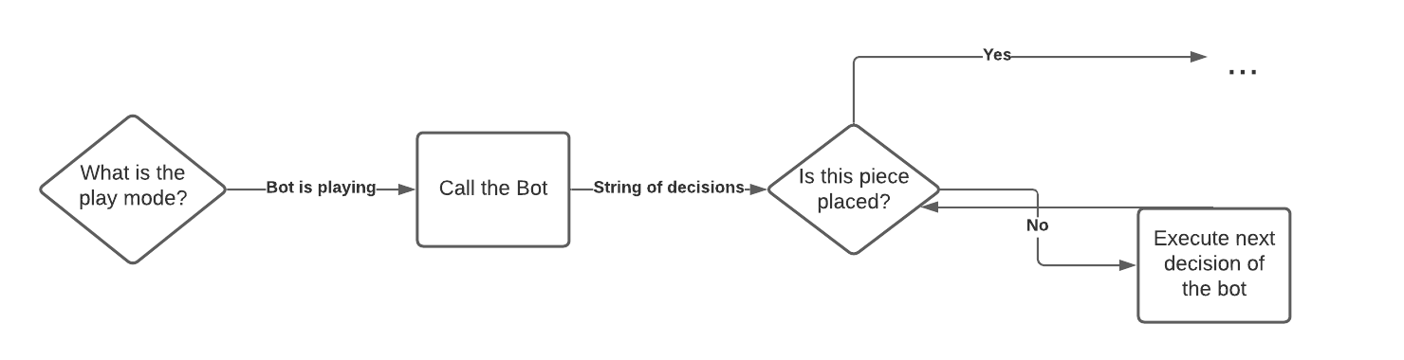
Agent mode

Slide 9
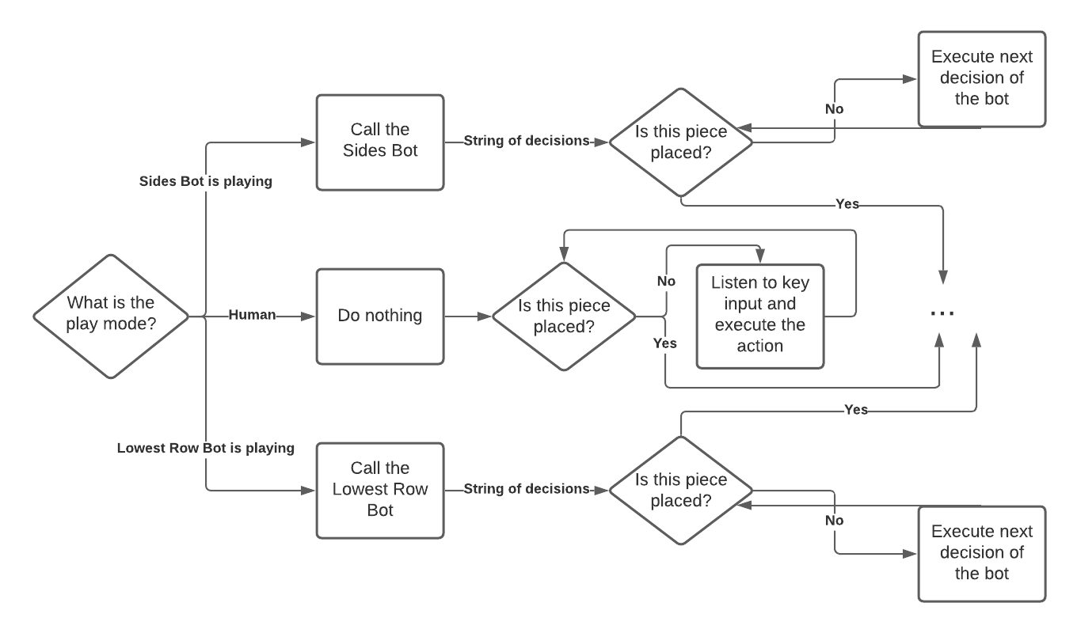
Zooming out

Slide 10
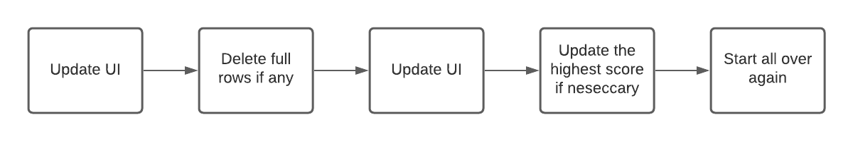
The end

Slide 11
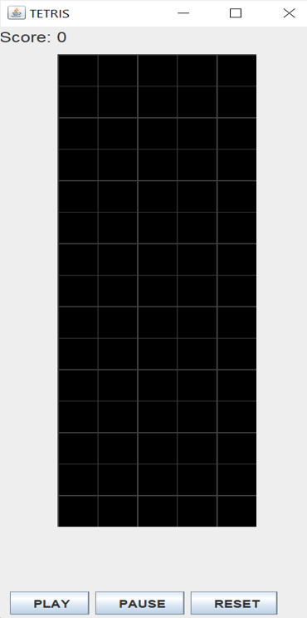
UI
Flow Layout - Border Layout
Visual Field
Score & Highest Score
Buttons: Play & Pause & Reset

Slide 12
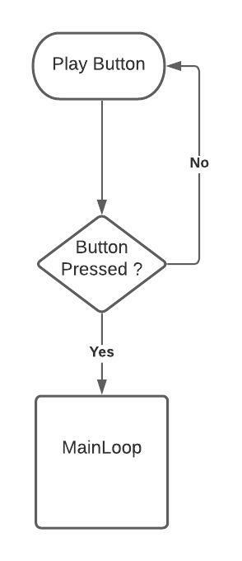
BUTTONS
UML Diagram : Play Button

Slide 13
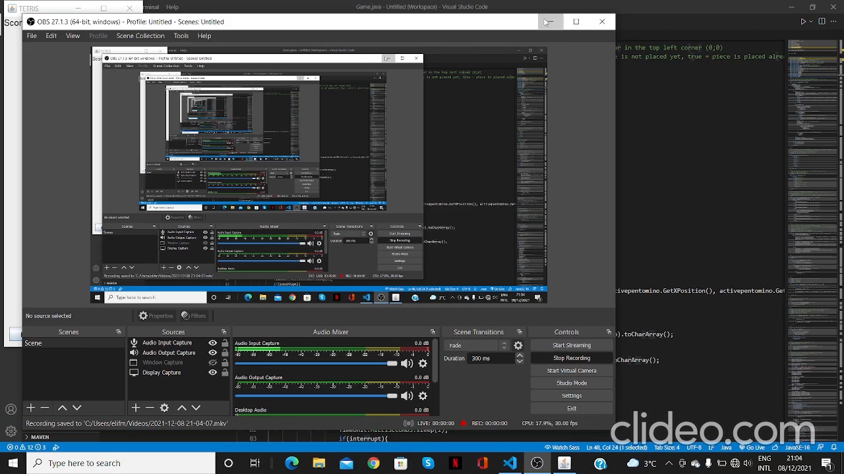

Slide 14
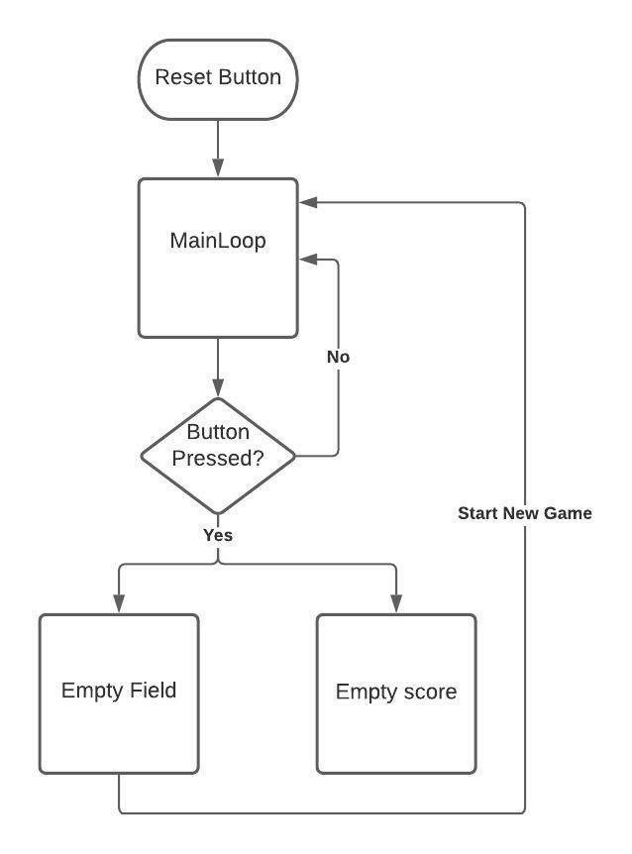
BUTTONS
UML Diagram : Reset Button

Slide 15
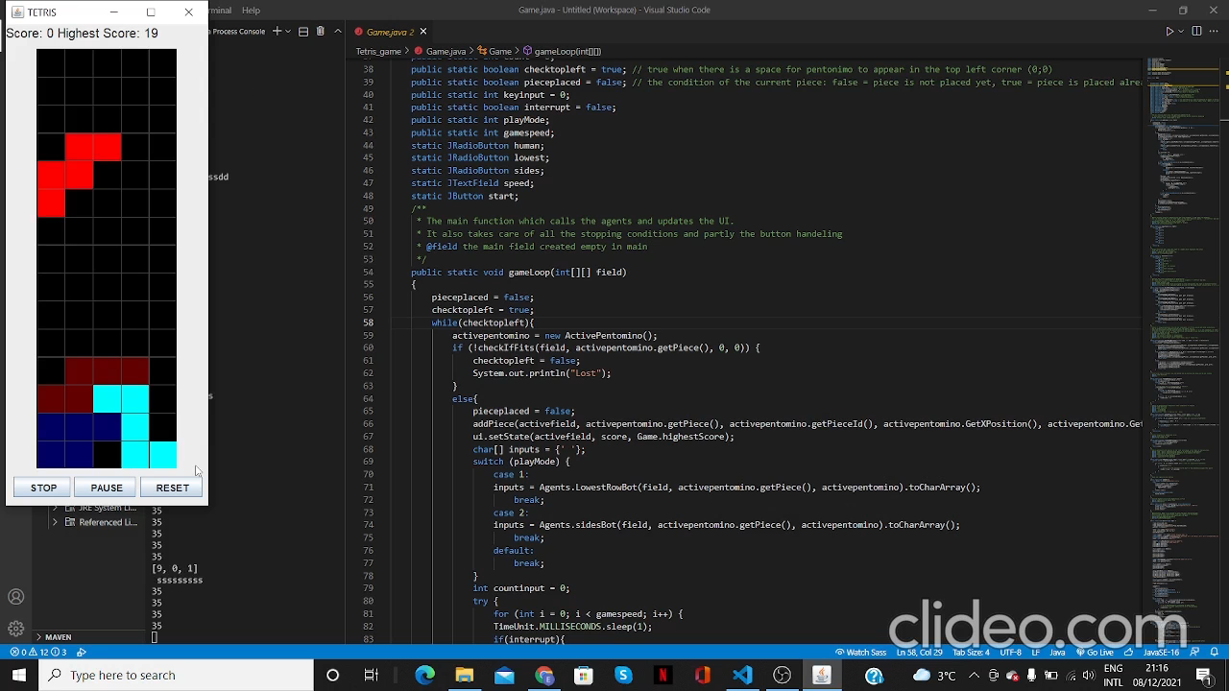

Slide 16
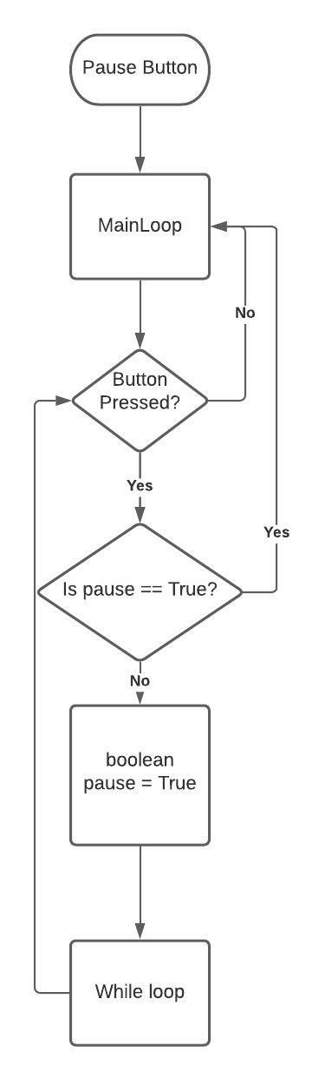
BUTTONS
UML Diagram : Pause Button

Slide 17
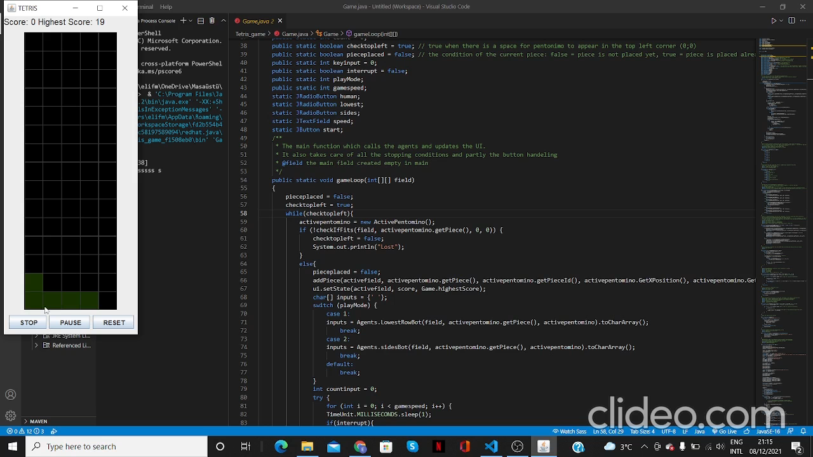

Slide 18
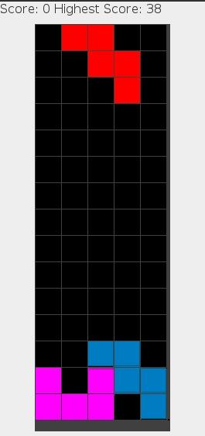
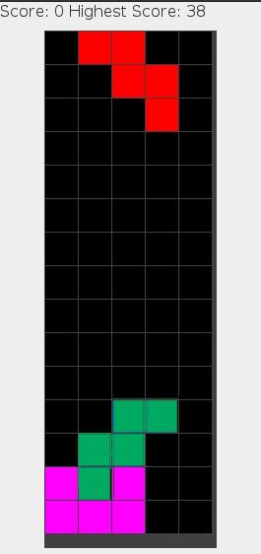
How can we play our game?
Model-based Reflex Agents
Lowest Row Agent
Sides Agent
Lowest Row Agent
SidesAgent
Notes:
Also talk about the limitations of our agent

Slide 19
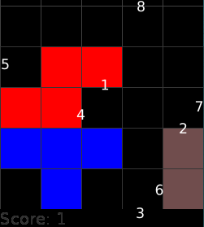
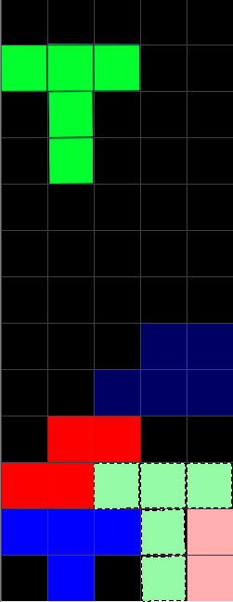
How we achieve this?
Recursive Escape
Recursive Escape
Assign Value
Assign Value

Slide 20
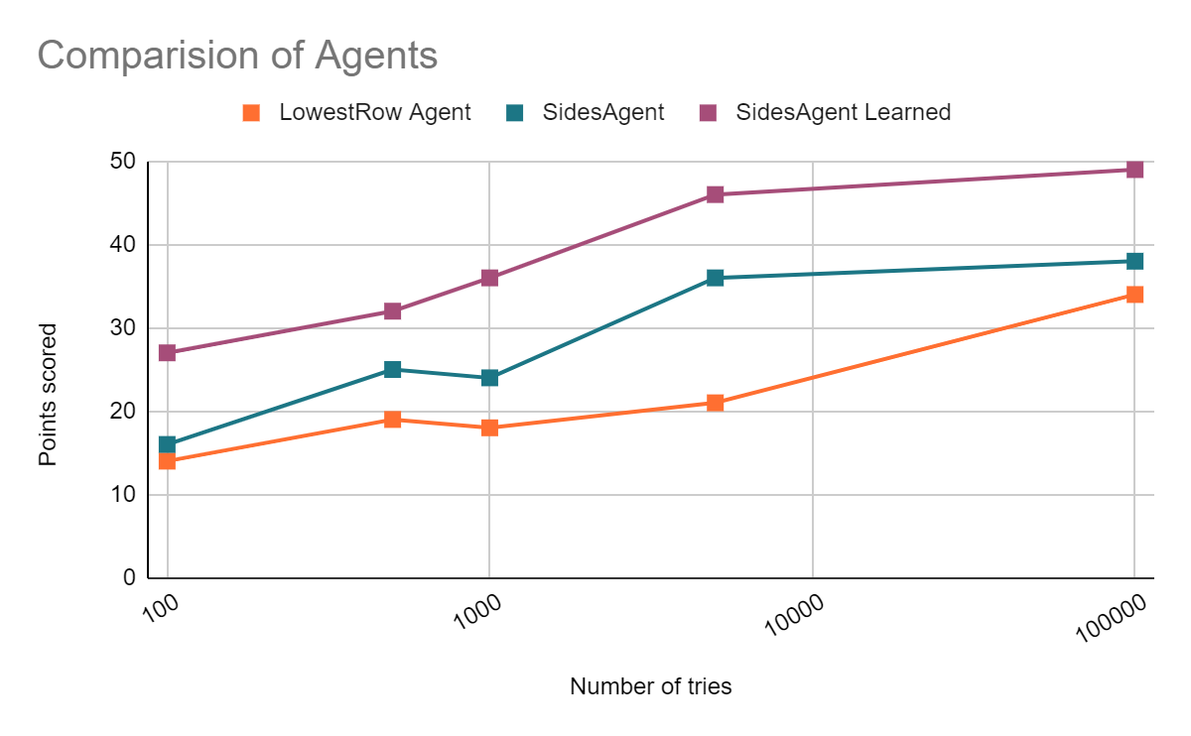
How do our methods compare to each other?
Sides Bot is ‘MORE EFFICIENT’ than Lowest Row Bot

Slide 21
How could we have continued?
Further Agent Implementation
A 4rd agent working as a « genetic algorithm» (convergence)
Further GUI + Game Implementation
Adding reward(s) for the user
Goal(s) for the user to beat the agent(s)

Slide 22
Thanks!
Any questions?

Slide 23
REFERENCES
More insight for the code:
Algorta, S., & Şimşek, Ö. (2019). The game of Tetris in machine learning. arXiv preprint arXiv:1905.01652.
More insight for the subject:
Low Tze Hui, S., & See, S. L. (n.d.). 6th International Conference on Applied Human Factors and Ergonomics (AHFE 2015) and the Affiliated Conferences, AHFE 2015. In Enhancing user experience through customisation of UI design. Retrieved November 30, 2021, from www.sciencedirect.com.
Lagoudakis, M. G., Parr, R., & Littman, M. L. (2002). Least-squares methods in reinforcement learning for control. In Hellenic conference on artificial intelligence (pp. 249-260). Springer, Berlin, Heidelberg.

Slide 24
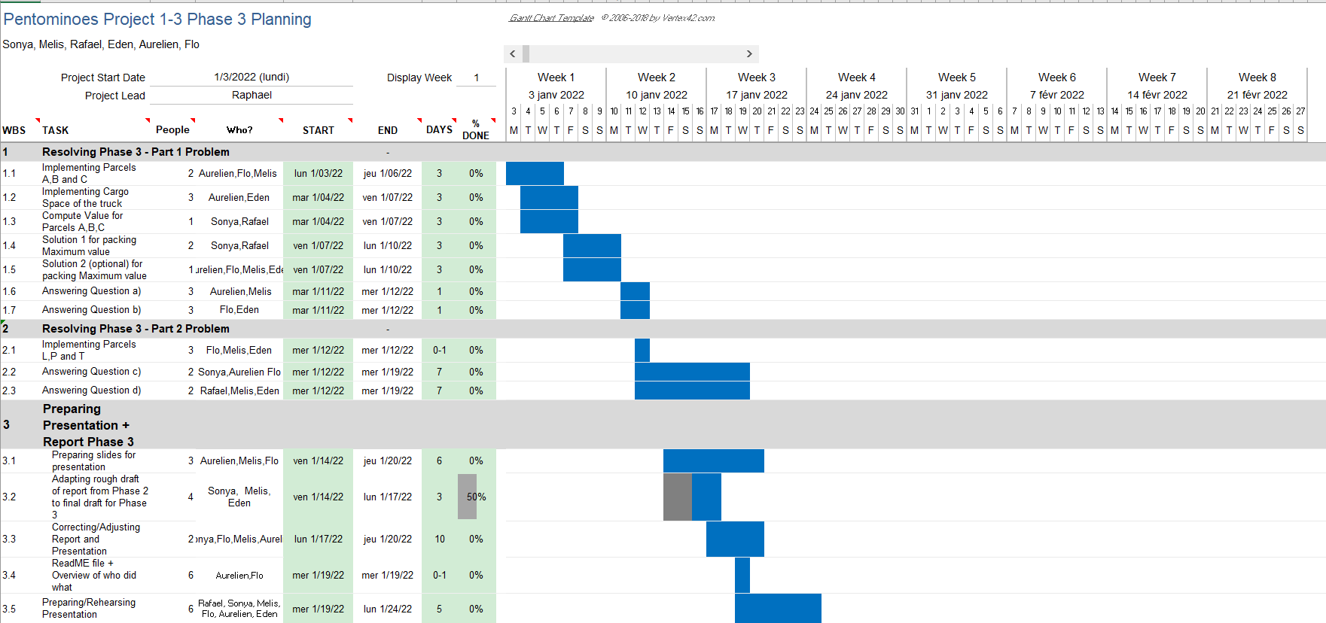
Planning for Phase 3

